Slide 1

TIME SERIES ANALYSIS
Arjun Mitra^{[a]}, Nehal Kanwar^{[b]} and Richa Rupera^{[c]}
^{[a][b][c]}Graduated student
School of Information and Technology
Vellore Institute of Technology
Vellore – 632014, Tamil Nadu, India.
E-mail: arjun.mitra2022@vitstudent.ac.in^{[a]}, nehal.kanwar2022@vitstudent.ac.in^{[b]}
richa.rupera2022@vitstudent.ac.in^{[c]}

Slide 2
ABSTRACT
The World is currently running on prediction, be it the weather, any natural calamities or the stock market. In every industry, prediction plays a major part. The more accurate the prediction the more successful the industry. The key to an accurate prediction is time series analysis. Any time series is complex, ever changing and notoriously difficult to predict. Factors such as economic indicators, political events, natural disasters, etc. can affect time series data such as share prices, currency values, oil prices, tourism market etc. Time series forecasting is generally preferred i.e. the process of predicting future movements in any given period of any data. The main objective of our paper is to merge suitable forecasting methods, which may give accurate short term, medium term or long-term results. Further, we will compare the merged method with any independent method.
Therefore, we will try to establish why the merged method may be better than the particular independent method.
Key words: time series, forecasting, prediction, trends, caret.

Slide 3
LITERATURE SURVEY
A literature review is a summary of previous research papers on a particular topic. It surveys scholarly articles, books, and other sources relevant to a particular area of research. Under this subheading, we have quoted multiple reviews as well as thoughts of renowned authors.
We have a glance at various statistical methods namely :-
● Naive() – It is based on historic data. The last period’s value becomes the current forecasted value.[5]
● SNaive ()- It stands for Seasonal Naïve. Seasonal naïve forecasting is similar to the naïve forecasting method, but its predictions are based on the previous values from the same season itself. [5]
● Regression () -Regression analysis is one of the most popular and straightforward techniques used when a correlation between the predicted value and other variables is desired. [3]

Slide 4
LITERATURE SURVEY
● Ses()- The Simple Exponential Smoothening technique is used for data that has no specific trend or seasonal pattern. [2]
● MA ()- Simple Moving Average is the average obtained from the data for some t period of time.[6]
● Holt()- This technique works with data having a trend but no seasonality. [2]
● Hw()- The Holt-Winter’s Seasonal method is used for data with both seasonal patterns and trends. [2]
● Linear and non-linear models ()- An equation that depicts the relationship between two variables with a steady rate of change is called a linear model. A nonlinear model describes an experimental dataset’s nonlinear relationships.[1]

Slide 5
PROBLEM DESCRIPTION
THE TWO MAJOR PROBLEMS CURRENTLY FACED WHILE IMPLEMENTING TIME SERIES ANALYSIS ARE:-
Forecasting – ‘cases’: collapses cannot be predicted.
Individual Events – examining individual events is not possible.

Slide 6
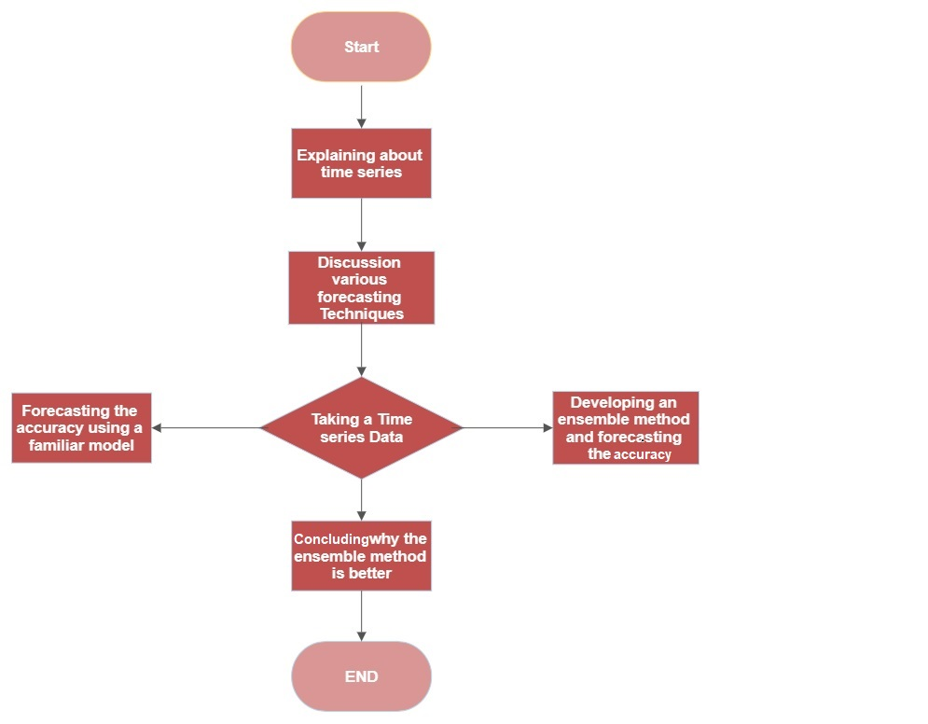
PROPOSED WORK AND DETAILED DESIGN
Fig. 1- The flowchart represents the architectural design of our work.

Slide 7
IMPLEMENTATION

Slide 8
INTRODUCTION
MODULE 1
WHAT IS TIME SERIES?
A set of observations of data obtained through repeated measures over different time intervals.
For an instance, if we take the number of people traveling to Mumbai from Kolkata every Tuesday over a year, that observation set will be known as a time series.

Slide 9
FEATURES OF TIME SERIES DATA
• Trends- The time series data has a visible pattern over time known as a trend.
• Seasonality- A seasonal pattern exists when a series is influenced by seasonal factors.
• Non-Seasonality- It is said when the data does not have many similarities and has different trends in different times.
• Steps- In a time series, observations where any sudden movements within the values occur for an outsized amount of your time or permanent time, we will call it the step in the time series.
• Pulses- During time series, observations where any sudden movements within the values occur for little amount of time or temporary time, we will call it Pulses in the time series.

Slide 10
MODULE 2
WHAT IS TIME SERIES FORECASTING?
Time series forecasting is making scientific predictions based on historical and current data. It involves building data predictive models through historical studying of data and using them to make observations and build future strategies. Time series forecasting is the process of analyzing time series data using statistical modeling methods. It is not always an accurate prediction because we deal with the commonly fluctuating variables in time series data as well as factors outside our control and knowledge. “Forecasting” and “prediction” has notable difference. Forecasting might refer to data at a specific future point in time, while prediction refers to future data in general. Time series analysis involves developing models to gain an understanding of the data to understand the underlying causes. Forecasting then takes the next step of what to do with that knowledge and future outcomes.

Slide 11
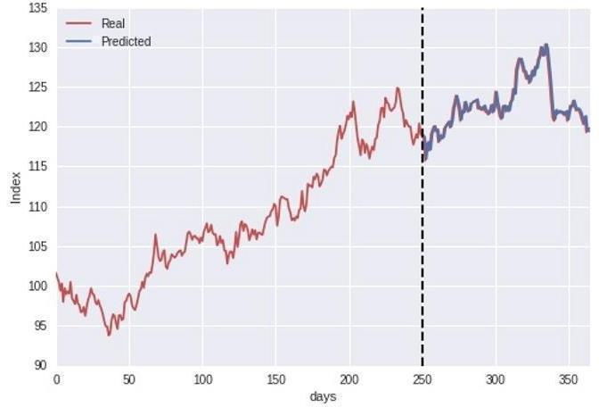
Some of the well-known time series forecasting techniques are:-
Regression analysis
Exponential smoothening
Moving Average
Naïve Figure 2 - A sample graph representing real and predicted data.

Slide 12
MODULE 3
NOW LET’S TAKE A TIME SERIES DATA AND FORECAST FUTURE VALUES
YEAR | 2011 | 2012 | 2013 | 2014 | 2015 | 2016 | 2017 | 2018 | 2019
NUMBER OF CARS SOLD (Cr.) | 1000 | 900 | 850 | 1050 | 1100 | 1200 | 1150 | 1120 | 1000

Slide 13
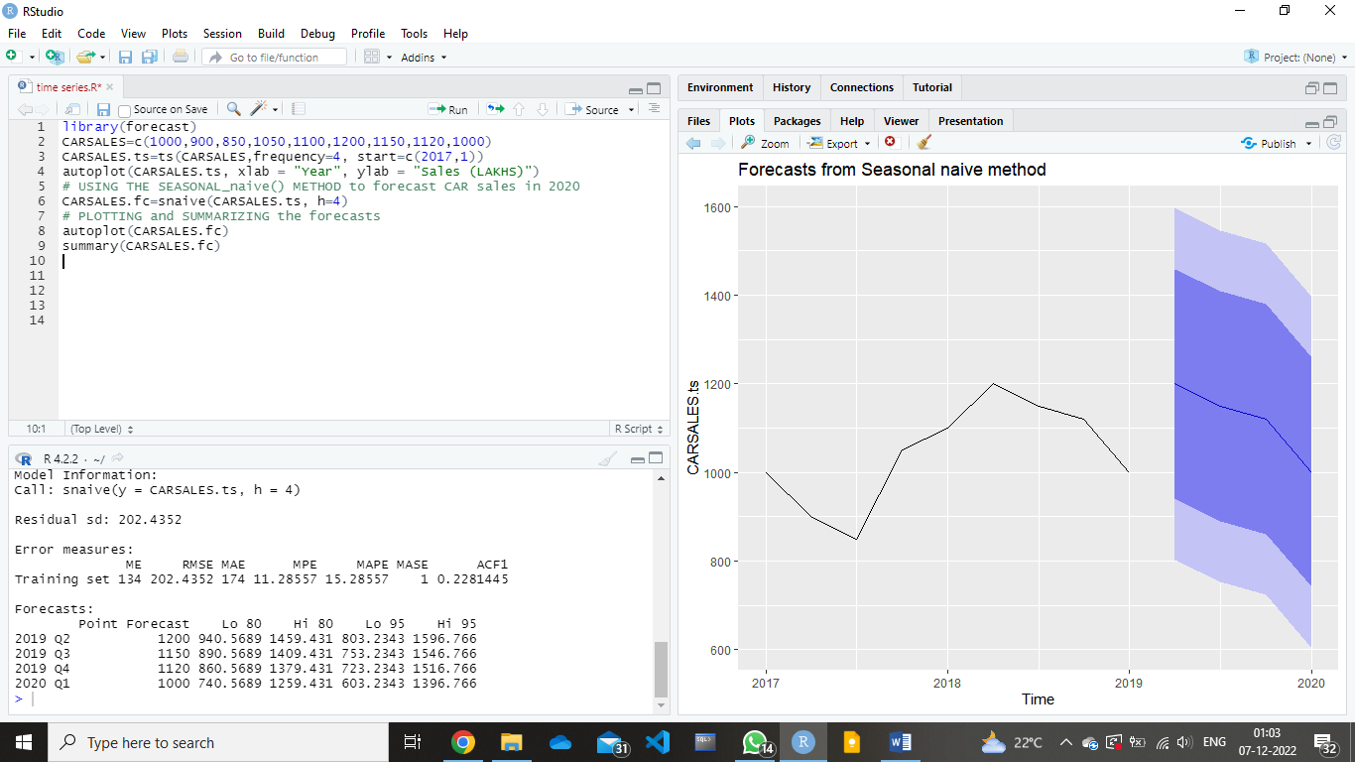
SEASONAL NAÏVE METHOD:-
CODE :

Slide 14
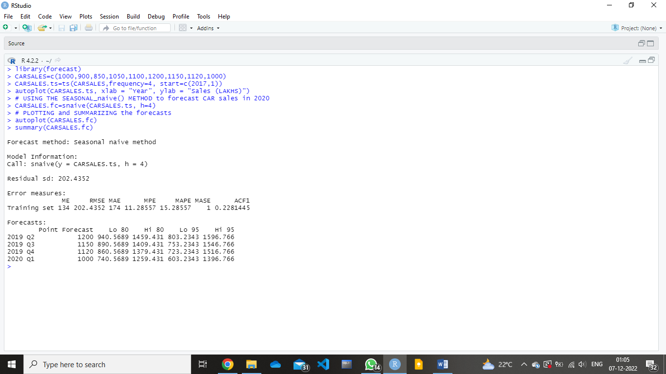
SEASONAL NAÏVE METHOD:-
OUTPUT :

Slide 15
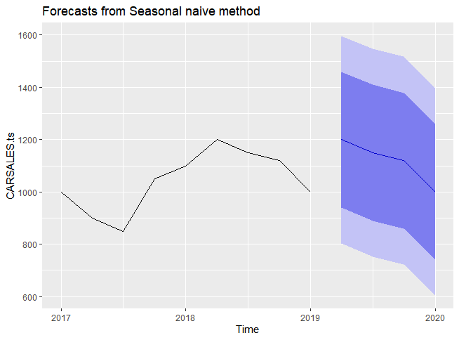
SEASONAL NAÏVE METHOD
GRAPH:

Slide 16
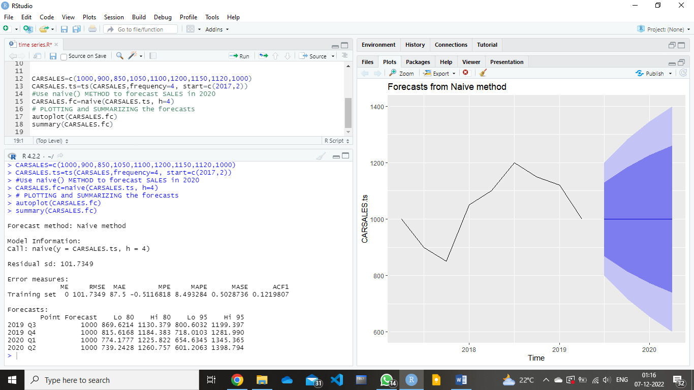
NAÏVE METHOD:-
CODE :

Slide 17
NAÏVE METHOD:-
OUTPUT :

Slide 18
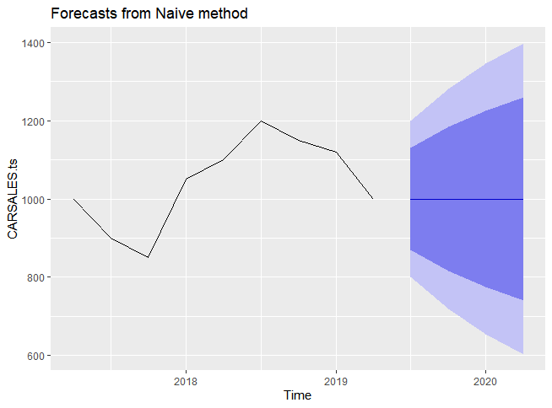
NAÏVE METHOD :
GRAPH

Slide 19
MODULE 4
Dataset
‘Vehicles’ data set is obtained through Hadley Wickham’s GitHub. [7] The data contains details of different components of various vehicles.

Slide 20
Experimental Procedure
We used ‘ensembling’ in the software named ‘R Studio’ and we did so by using ‘caret’ packages. An ensemble briefly means stacking models together. We can model a data set with one model and it will have an understanding of the data, but if we use different models especially diverse models that will approach the data differently.
As a result, one will have a wider understanding of the dataset and especially for a complex dataset, it will increase the accuracy theoretically and stability over predictions over the long run. The packages we used are : ‘{caret}’ ,‘{RCurl}’ and ‘{pROC}’.
We used the caret library since it offers a unified language with functions and commands that generalized, so that we can talk to variety of models using the same constructs. We then used the ‘getModelnfo()’ function of the caret library which displays all the models that are supported.

Slide 21
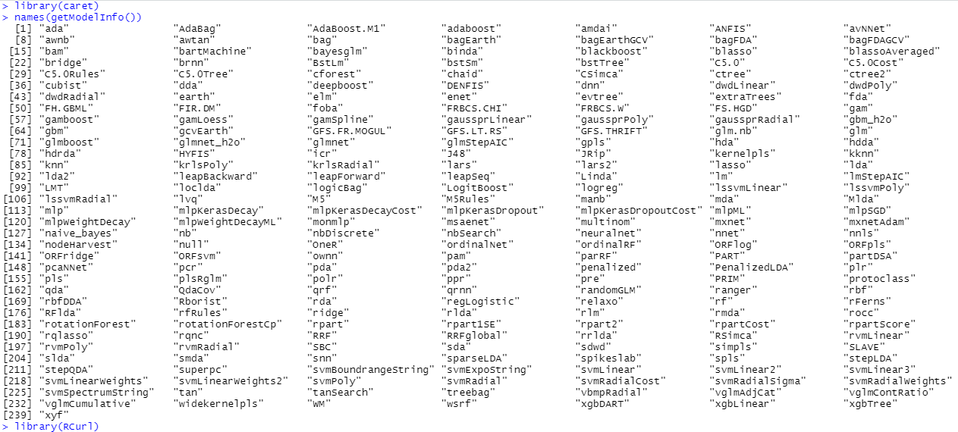
Fig 3 - Introducing the ‘Rcurl’ package and ‘caret’ package with all the supported models.

Slide 22
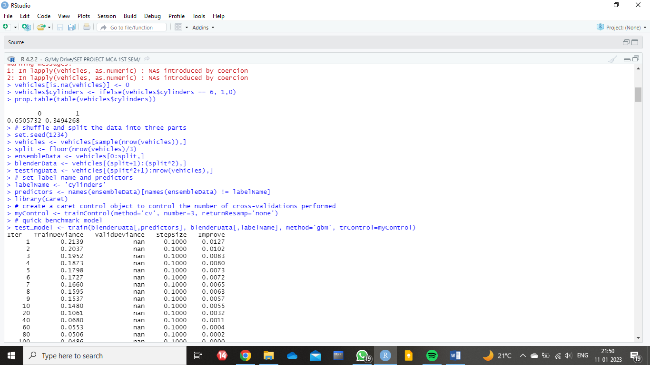
Fig 4 - Representation of the division of data into three parts.
The vehicle dataset basically talks about energy consumption of different vehicles. We took the first 30 columns from vehicle dataset and a variable cylinder where 6 cylinders is considered to be 1 and any other number of cylinders is considered to be 0. This acted as the target variable or response variable. All the other columns were used to predict the number of cylinders. In order to make the ensemble model work, we divided the data equally into three parts which are named ‘ensembleData’, ‘blenderData’ and ‘testingData’.

Slide 23
THE MODELS WE HAVE USED:-
Treebag() - Bagging algorithm is used to increase model accuracy in regression and classification problems. Classification with a bagging (treebag) method in R. The fundamental idea behind bagging algorithms is to build multiple models from distinct subsets of train data before creating a final aggregated and more precise model.
Rpart() - Building classification and regression trees uses Rpart, a robust machine learning library in R. Recursive partitioning is implemented by this library, which is also very simple to use.
GBM()- The full form is ‘Gradient Boosting Machine’. The combines the predictions from various decision trees to create the ultimate predictions,

Slide 24
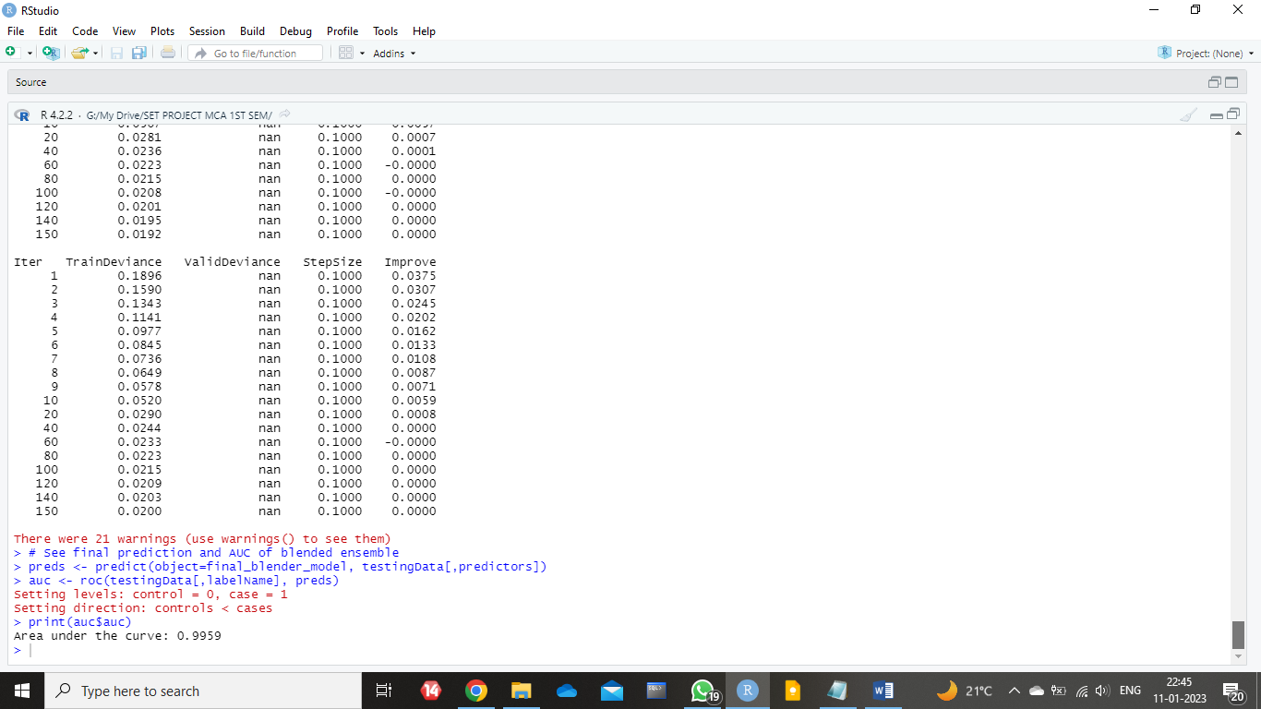
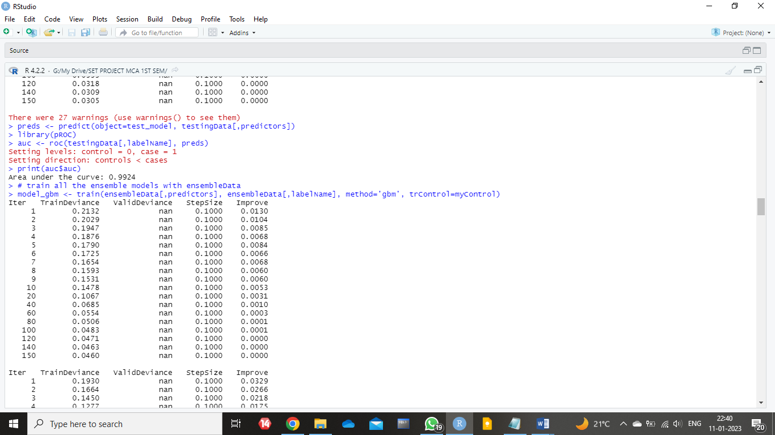
Results and Discussions
We got the area under curve value 0.9959. Then, we repeated the same for the original dataset & predicted area under the curve.
Fig 5 - Prediction of Area under the Curve for blended ensemble.
Fig 6 - Predicting Area under the
Curve for initial blended data.
We found the predicted value to be 0.9924. The model on its own ‘gbm’ with the original data gives a 0.9924 while the model enhanced by adding probabilities from diverse models gives us a slightly higher area under the curve. We managed to increase the value of the area under the curve with the use of three models. We got the benefit of an additional extra model as well as an extra way of analyzing the data.

Slide 25
Conclusion
This paper represents an empirical study on the basics of time series, forecasting and time series forecasting techniques. We have tried to establish why using multiple methods together can be much more helpful as well as accurate for forecasting. Upon altering the initial blender dataset and testing dataset by adding additional features to the original datasets, we successfully built the new or enhanced dataset which consisted of three new additional columns of probabilities. Further, we predicted the area under the curve for both the datasets. The value for the enhanced blender data was predicted as 0.9959. Similarly, the value for area under the curve for the original blender dataset was predicted as 0.9924. Thereby we can conclude that by using ensemble we increased the expected value by 0.0035.

Slide 26
Acknowledgement
We would like to thank our reverent guide, Dr. Santhi K ma’am for always being a constant support for us throughout this process. She helped us in not only writing the paper, but also properly showed us the keys and tactics of doing a research. Overall, her presence was a crucial factor to the completion of the project.
Conflict of Interest Statement
With relation to the project done , we have no conflict of interest.

Slide 27
REFERENCES:-
1) Stock, J. H., & Watson, M. W. (1998). A comparison of linear and nonlinear univariate models for forecasting macroeconomic time series.
2) Mahalakshmi, G., Sridevi, S., & Rajaram, S. (2016, January). A survey on forecasting of time series data. In 2016 International conference on Computing Technologies and Intelligent Data Engineering (ICCTIDE'16) (pp. 1-8). IEEE.
3) Athiyarath, S., Paul, M., & Krishnaswamy, S. (2020). A comparative study and analysis of time series forecasting techniques. SN Computer Science, 1(3), 1-7.
4) Semenoglou, A. A., Spiliotis, E., Makridakis, S., & Assimakopoulos, V. (2021). Investigating the accuracy of cross-learning time series forecasting methods. International Journal of Forecasting, 37(3), 1072-1084.

Slide 28
5) Syu, Y., Kuo, J. Y., & Fanjiang, Y. Y. (2017). Time series forecasting for dynamic quality of web services: an empirical study. Journal of Systems and Software, 134, 279-303.
6) Deb, C., Zhang, F., Yang, J., Lee, S. E., & Shah, K. W. (2017). A review on time series forecasting techniques for building energy consumption. Renewable and Sustainable Energy Reviews, 74, 902-924.
7) Hadley Wickham (2008). Details of different components of various vehicles. https://github.com/hadley

Slide 29
THANK YOU!

